Slide 1
Classifications of Mushrooms
Karthik Sakthikanesan

Slide 2
The Problem
Mushrooms can either be edible or poisonous.
Based on a number of physical characteristics , I wanted to see if it was possible to figure out if a mushroom is edible or poisonous. This is a binary classification problem.
I also wanted to find out what features let us easily identify if a mushroom is poisonous or not.
Among the known mushroom species:
20% are poisonous
1% are deadly
1% are psychoactive
78% are non-toxic
It is estimated that there are 5.1 different species.

Slide 3
The Data
I found the dataset on kaggle. It was originally on the UCI Machine Learning repository.
There are 8124 observations and 23 columns (22 features).
There is a nearly even split between poisonous and edible mushrooms (52/48), no over sampling is needed. (This is the feature ‘class’)
All of the variables are categorical.
The data is very clean; no missing values.

Slide 4
The Variables with levels
Class – edible, poisonous
Cap-shape – bell, conical, convex, flat, knobbed, sunken
Cap-surface – fibrous, grooves, scaly, smooth
Cap-color – brown, buff, cinnamon, gray, green, pink, purple, red, white, yellow
Bruises – bruises, no bruises
Odor – almond, anise, creosate, fishy, foul, musty, none, pungent, spicy
Gill-attachment – attached, descending, free, notched
Gill-spacing – close, crowded, distant
Gill-size – broad, narrow
Gill-color – 12 levels
And 12 more…

Slide 5
Things to be done
The number of variables has to be reduced as 22 features is difficult to work with.
Have to make sure that the variables are not too correlated.
The number of levels for certain variables has to be reduced. It is unlikely that all the levels for all the features will be important.

Slide 6
Feature Selection
By looking at the number of occurrences of each level for each feature, I was able to eliminate one feature. Veil-type is always ‘partial’, this won’t be useful so I removed it.
On creating a correlation matrix using the Goodman and Kruskal’s Tau test
I found that gill-attachment and stalk-shape have a very low correlation to class. Looking at the levels within these variables, it looked like they are not indicative of ‘class’. I removed both these features.
The variable ‘odor’ has a 0.943 correlation to ‘class’. This will be an important variable.
There were no other values that were prominent.

Slide 7
Feature Selection
Using the variable importance attribute of randomForest
On running the model, I noticed that it had 100% accuracy with an estimated OOB error of 0%.
I got the variable importance and plotted it to see the what variables were important to this particular model.

Slide 8
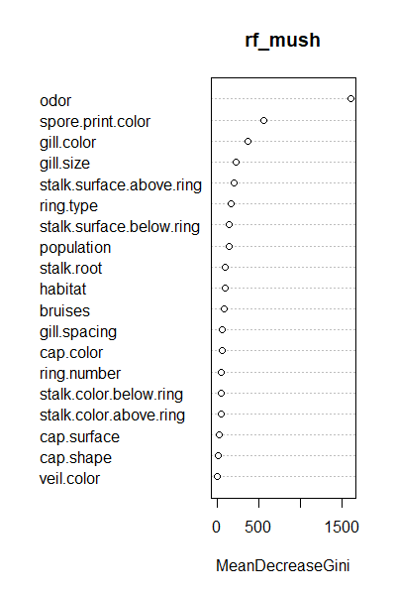
Feature Selection
Based on this graph, I decided to use only the first 5 variables, namely ‘odor’, ‘spore.print.color’, ‘gill.color’, ‘gill.size’ and ‘ring.type’. Though I might get rid of a few more while creating the models.

Slide 9
Final Variables
For ‘odor’, given that there’s an odor, you can definitively say whether a mushroom is edible or not. If there’s no odor, it’s generally edible (96%) but that’s not certain.
For ‘spore.print.color’, ‘gill.color’, ‘gill.size’ and ‘stak.surface.above.ring’ every level tends to be completely or at least tend to edible or poisonous.

Slide 10
Features Added
I created another dataset with the dummy variables of binary variables for each level of each column in order to train a neural network.

Slide 11
Models to be Used
randomForest – due to the variables all being categorical, this makes sense
Neural network – I don’t have much experience with this model and I think I’ll be spending most of my remaining time working on this, especially since the data was handled so effectively by randomForest.
XGboost – I’ve had success with this algorithm before so I’d like to see how it works on this data.
NOTE: as I was able to get perfect accuracy with randomForest, I will be using that as the benchmark. I will also be trying to create models without using the ‘odor’ feature.

Slide 12
QUESTIONS?

